Slide 1
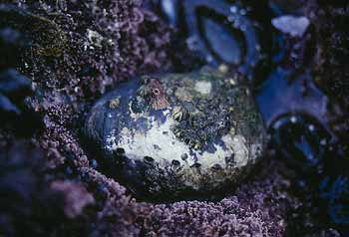
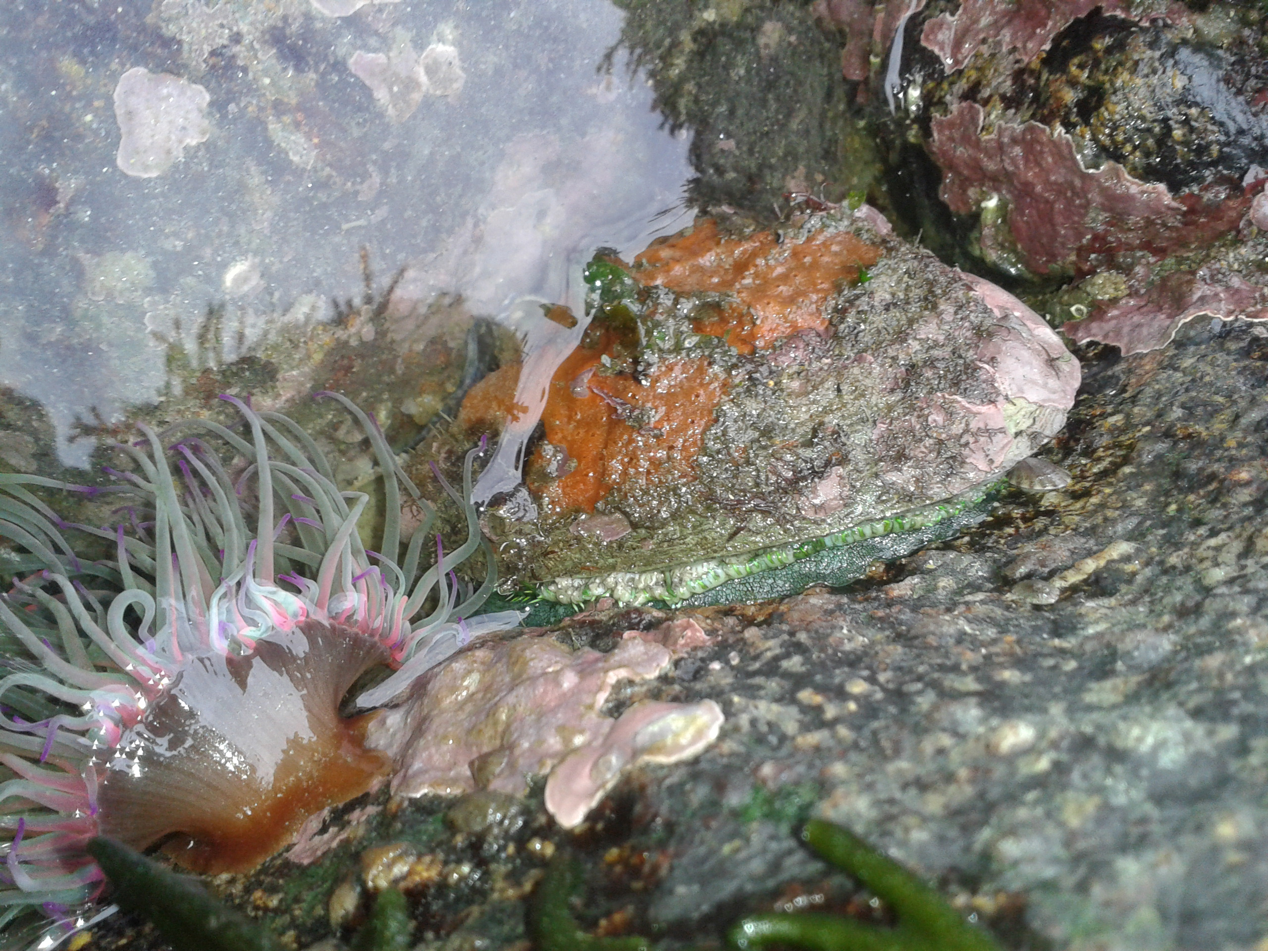
Project 3
Predicting the Age of Abalone using Machine Learning and Neural Networks
Group NoFloods
Amit Patel
Daniah Al Bayati
Roopa Patel
Samuel Parks
Steven Lee

Slide 2
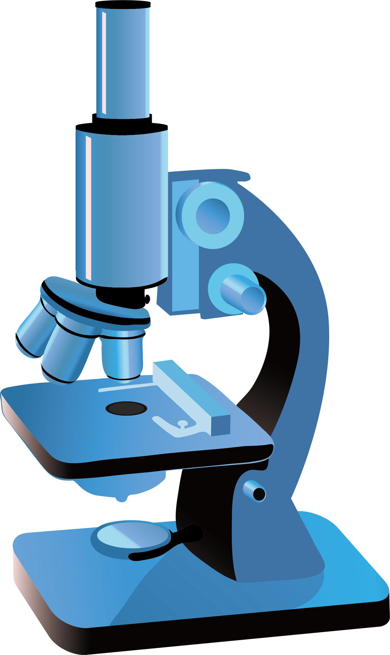
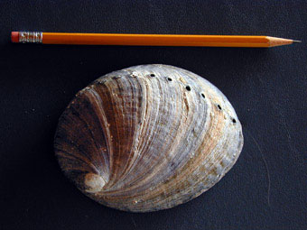
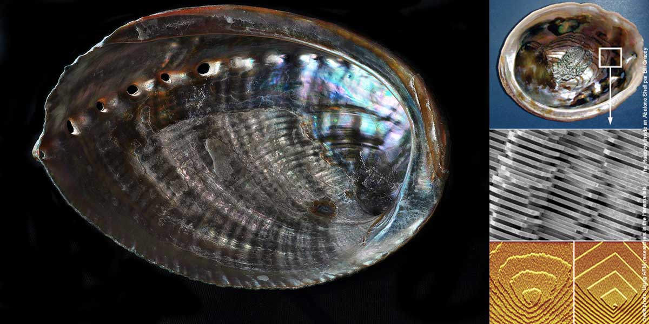
Project Goal
Predict the age of abalone using physical characteristics
Use Machine Learning and Neural Network models
vs

Slide 3
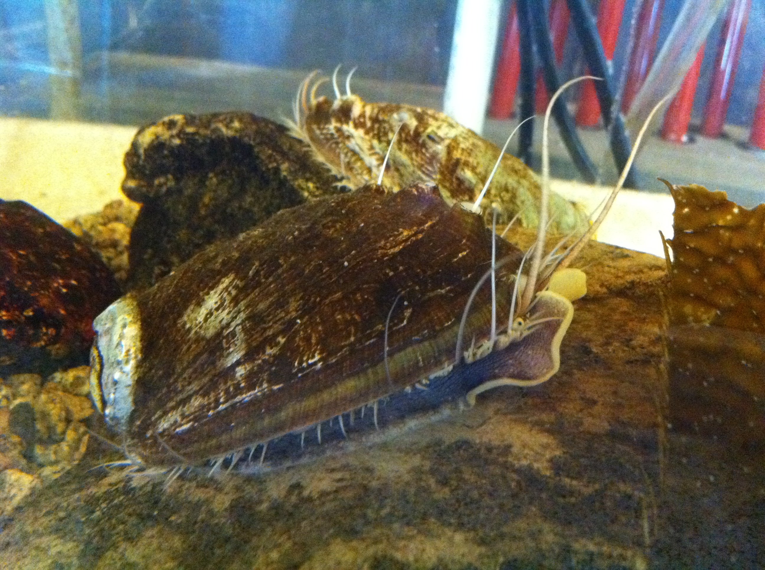
What is an abalone?
Abalone are marine snails
From Wikipedia, an abalone is a common name for any of a group of small to very large sea snails, marine gastropod molluscs in the family Haliotidae
Vary in length from 20mm – 200mm
Commonly used for food and jewelry

Slide 4
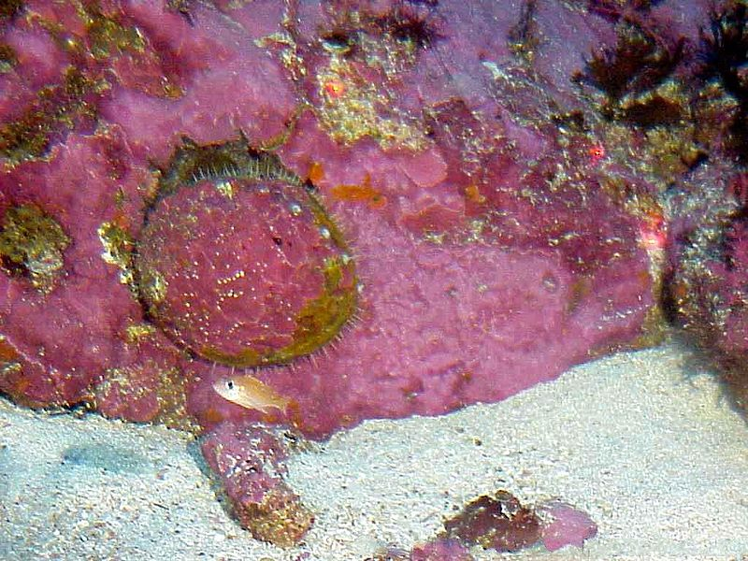
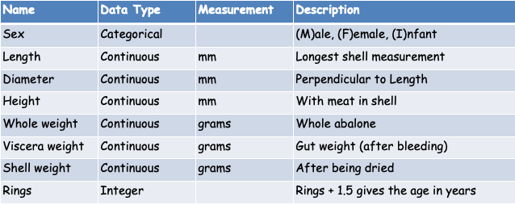
Data Source
University of California, Irvine (UCI) ML Repository https://archive.ics.uci.edu/ml/datasets/Abalone
4,177 rows with 8 attributes
Mostly continuous variables, with one categorical and one integer
For our models, we are trying to predict “Rings” (supervised model)
Age is directly related to Rings: Age = Rings + 1.5

Slide 5
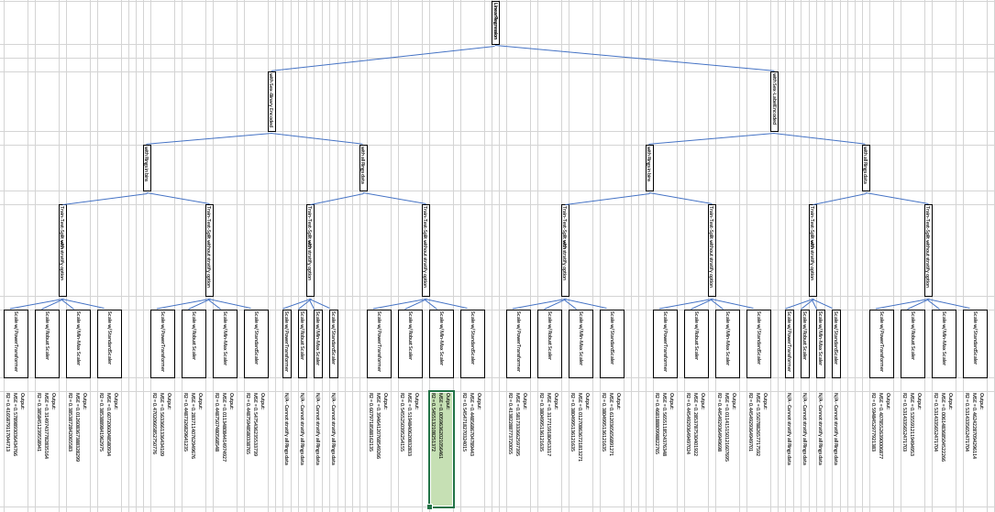
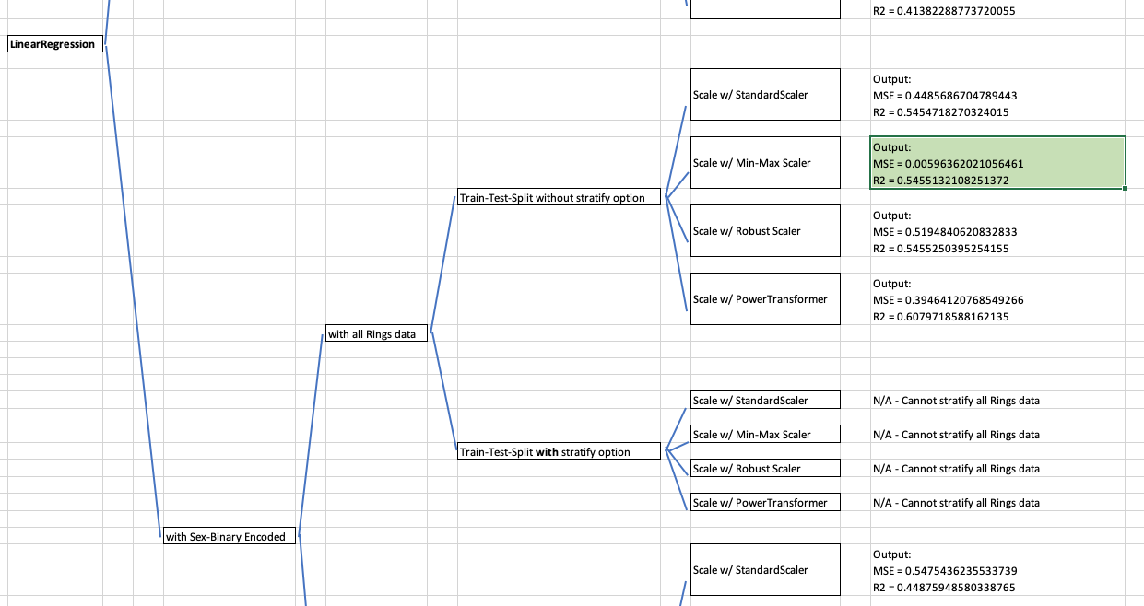
Our Methods
Data Preprocessing
ML Modeling
Linear Regression
Classification
H2O AutoML
Neural Networks
Simple
Deep

Slide 6
Section break (Speaker change)

Slide 7
Descriptive Analytics
Slide text

Slide 8
Descriptive Analytics
Slide text

Slide 9
Descriptive Analytics
Slide text

Slide 10
Section break (Speaker change)

Slide 11
Linear Regression Models
Slide text

Slide 12
Linear Regression Models
Slide text

Slide 13
Section break (Speaker change)

Slide 14
Classification Models
Slide text

Slide 15
Classification Models
Slide text

Slide 16
Section break (Speaker change)

Slide 17
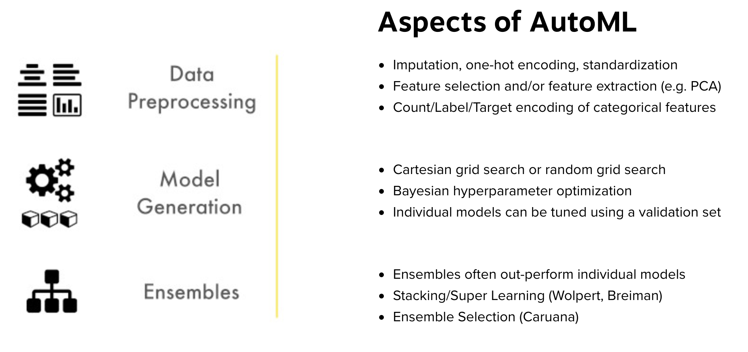
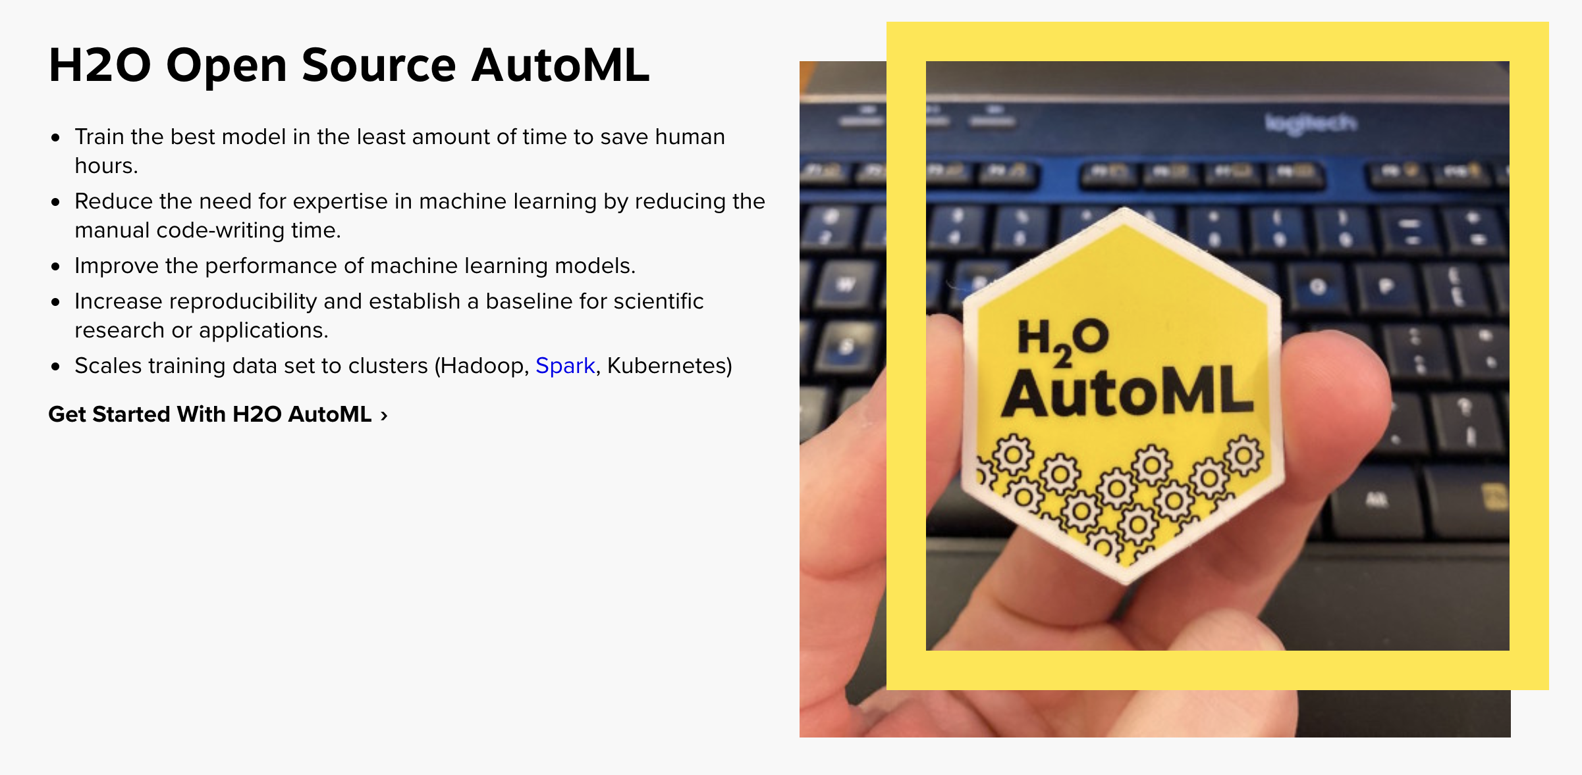
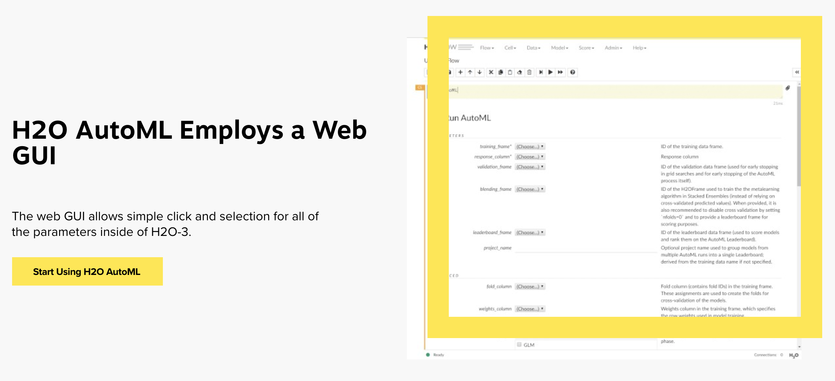
H2O AutoML: What is it?
From https://www.h2o.ai/products/h2o-automl/:
AutoML or Automatic Machine Learning is the process of automating algorithm selection, feature generation, hyperparameter tuning, iterative modeling, and model assessment

Slide 18
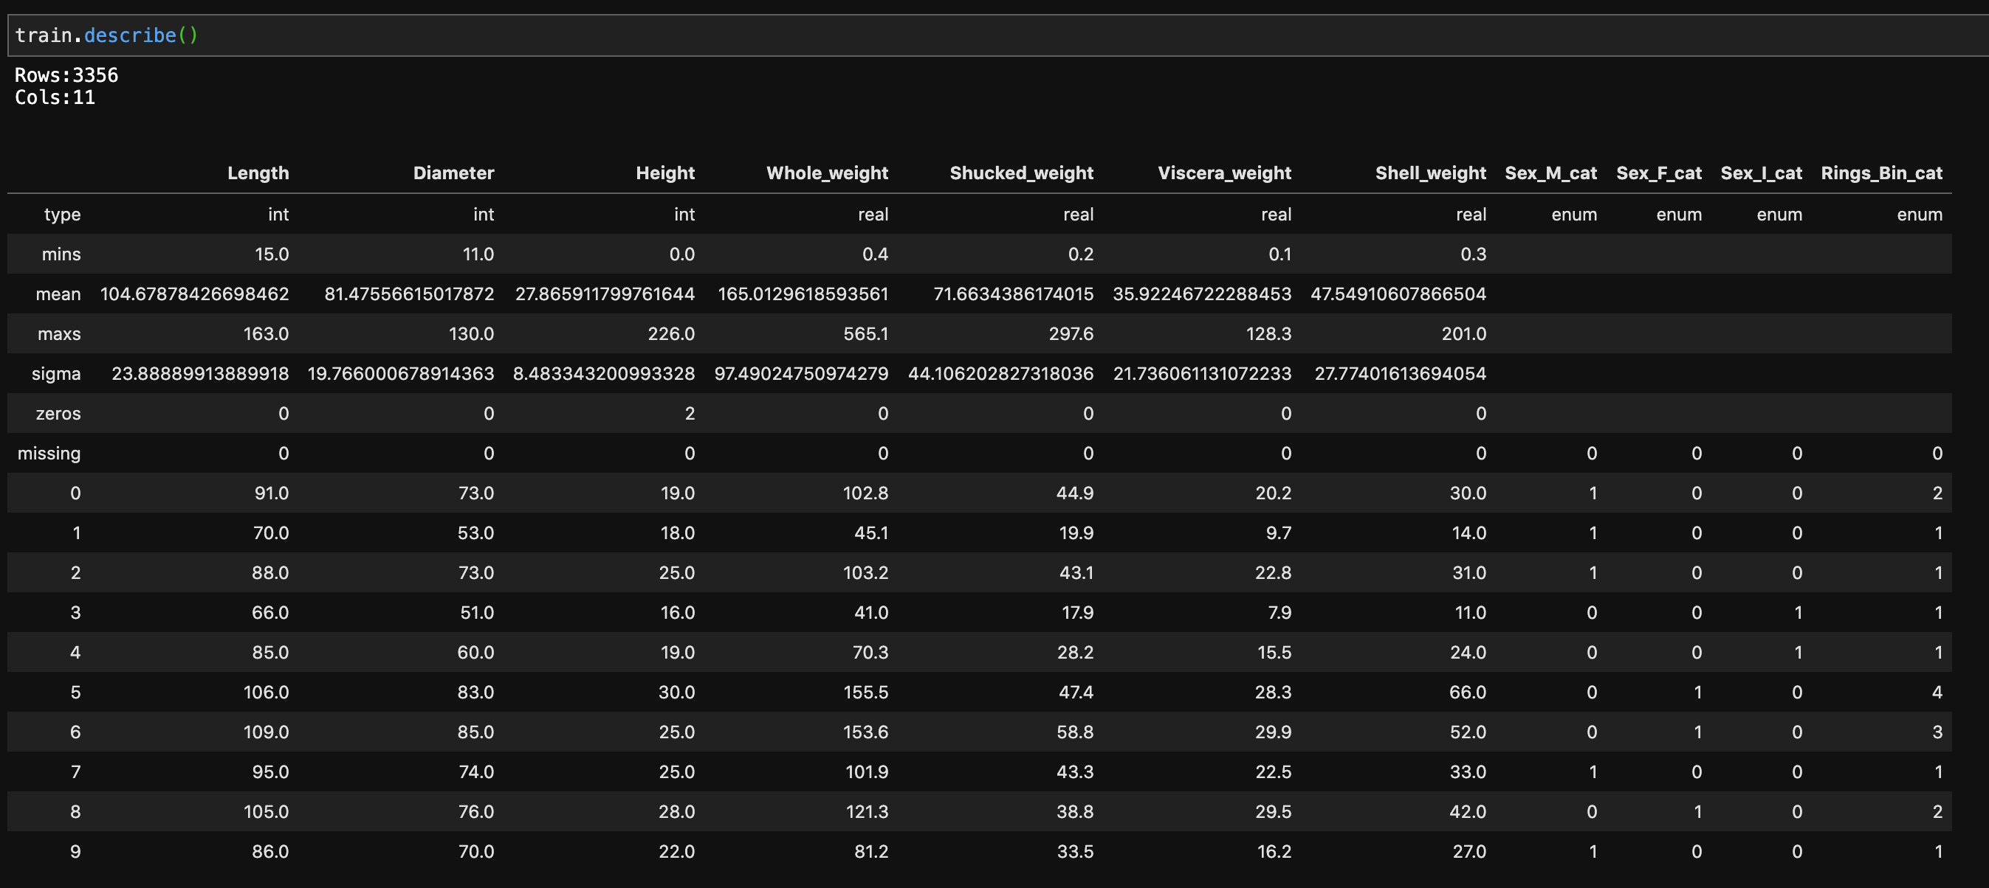
H2O AutoML: Preprocessing and Train-Test-Split
Usual data preprocessing, but H2OFrames are required (like pandas dataframes)
Train-Test-Split uses H2O’s split_frame() method
Categorical variables types need to be ‘enums’ using .asfactor()

Slide 19
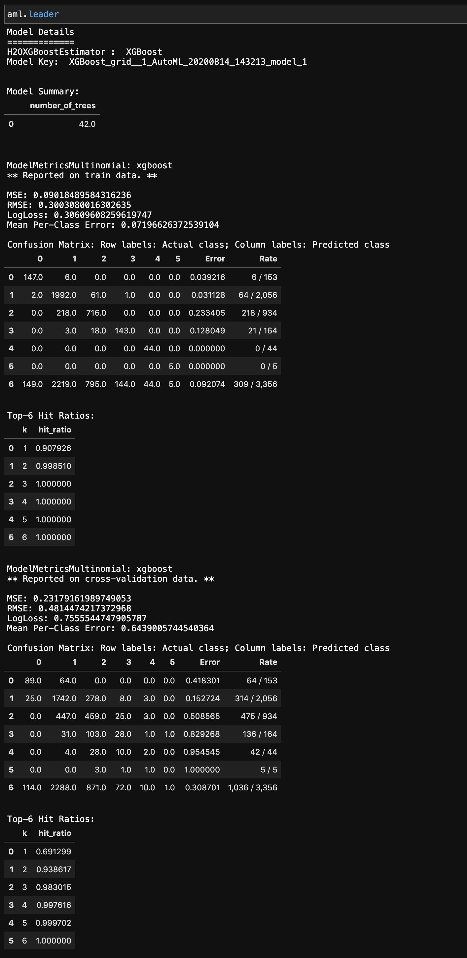
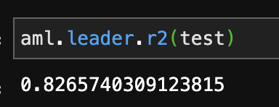
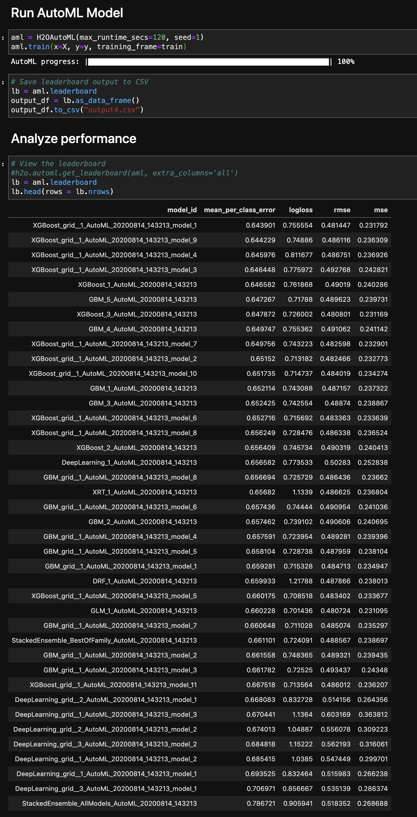
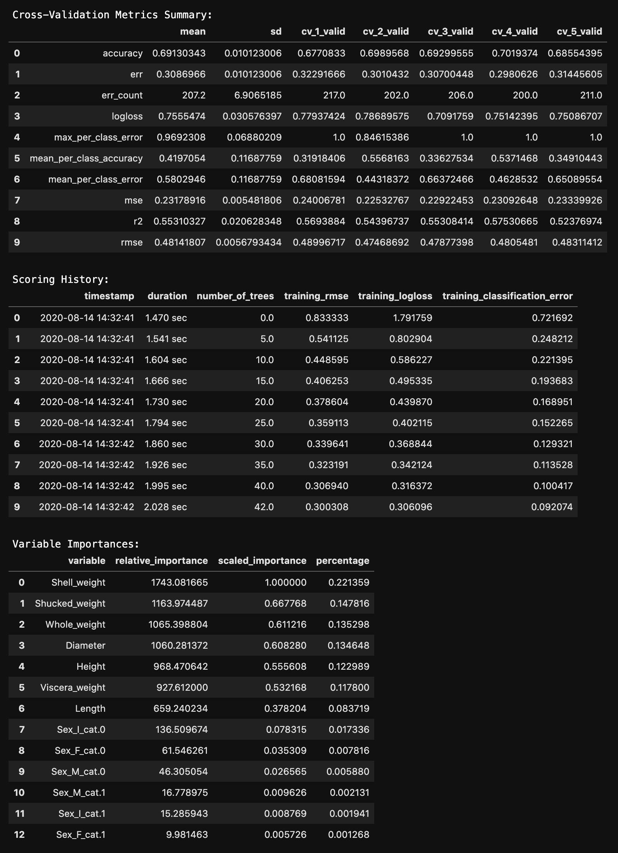
H2O AutoML: Training and the Leaderboard
After training the model, the leaderboard ranks models
You can further drill-down into the leader’s performance

Slide 20
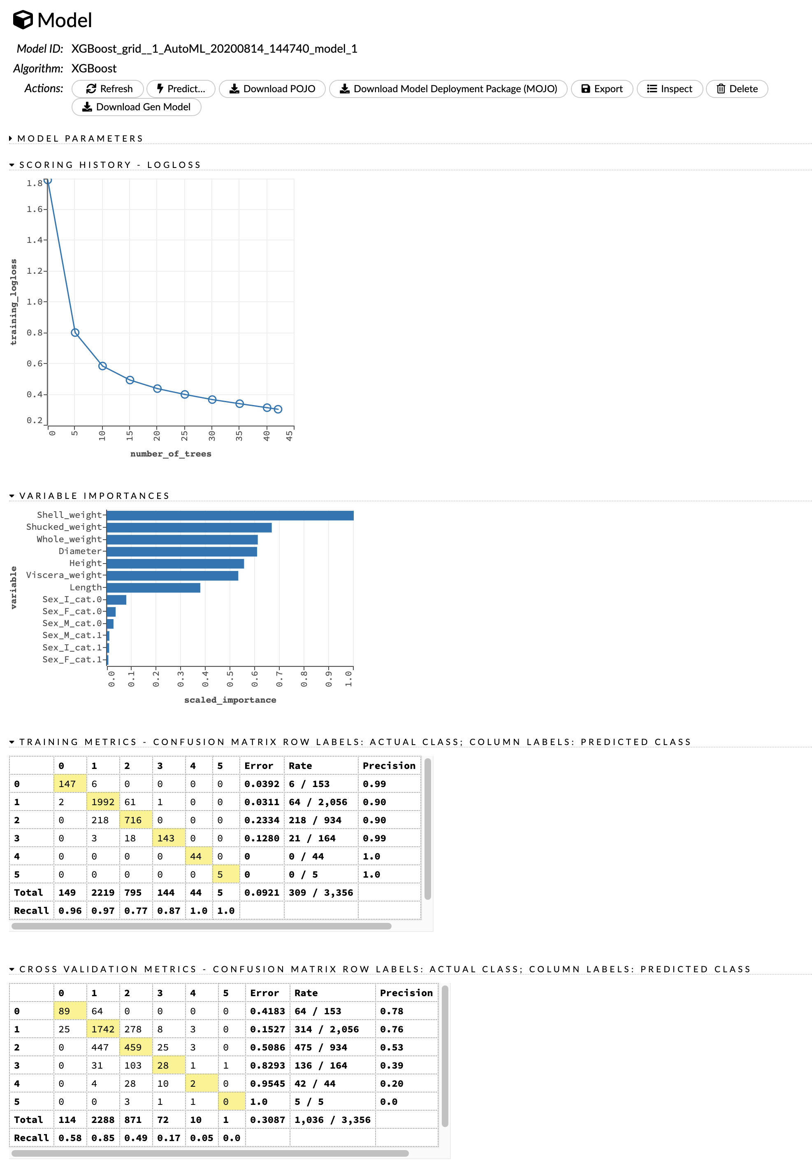
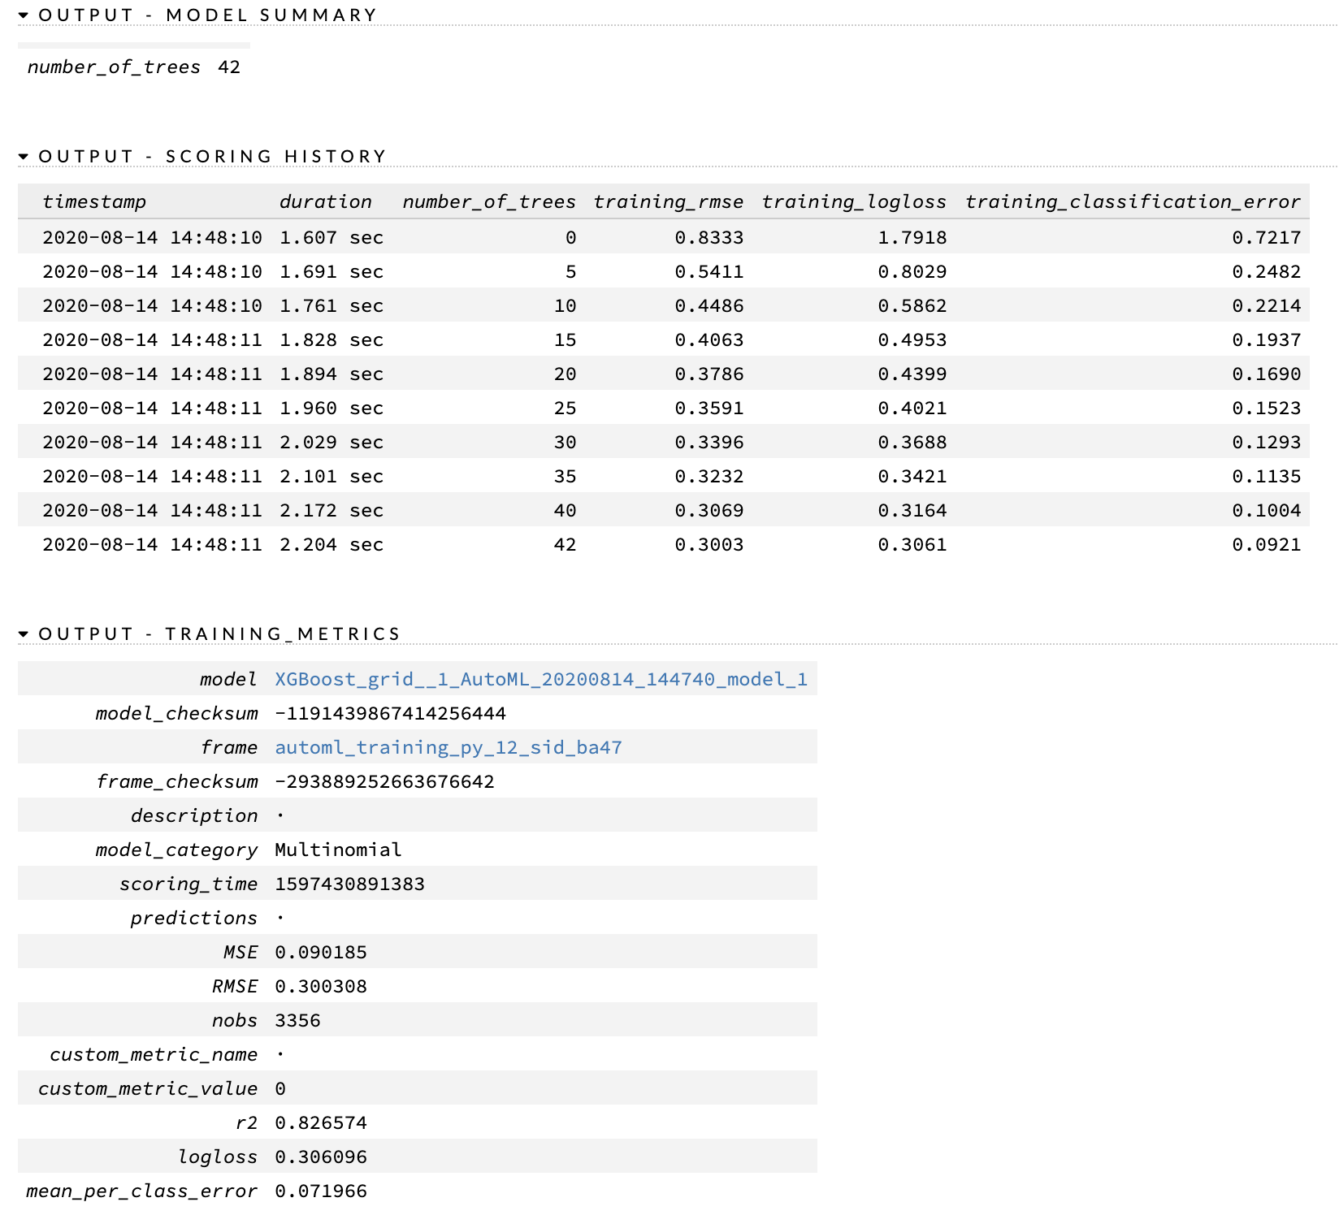
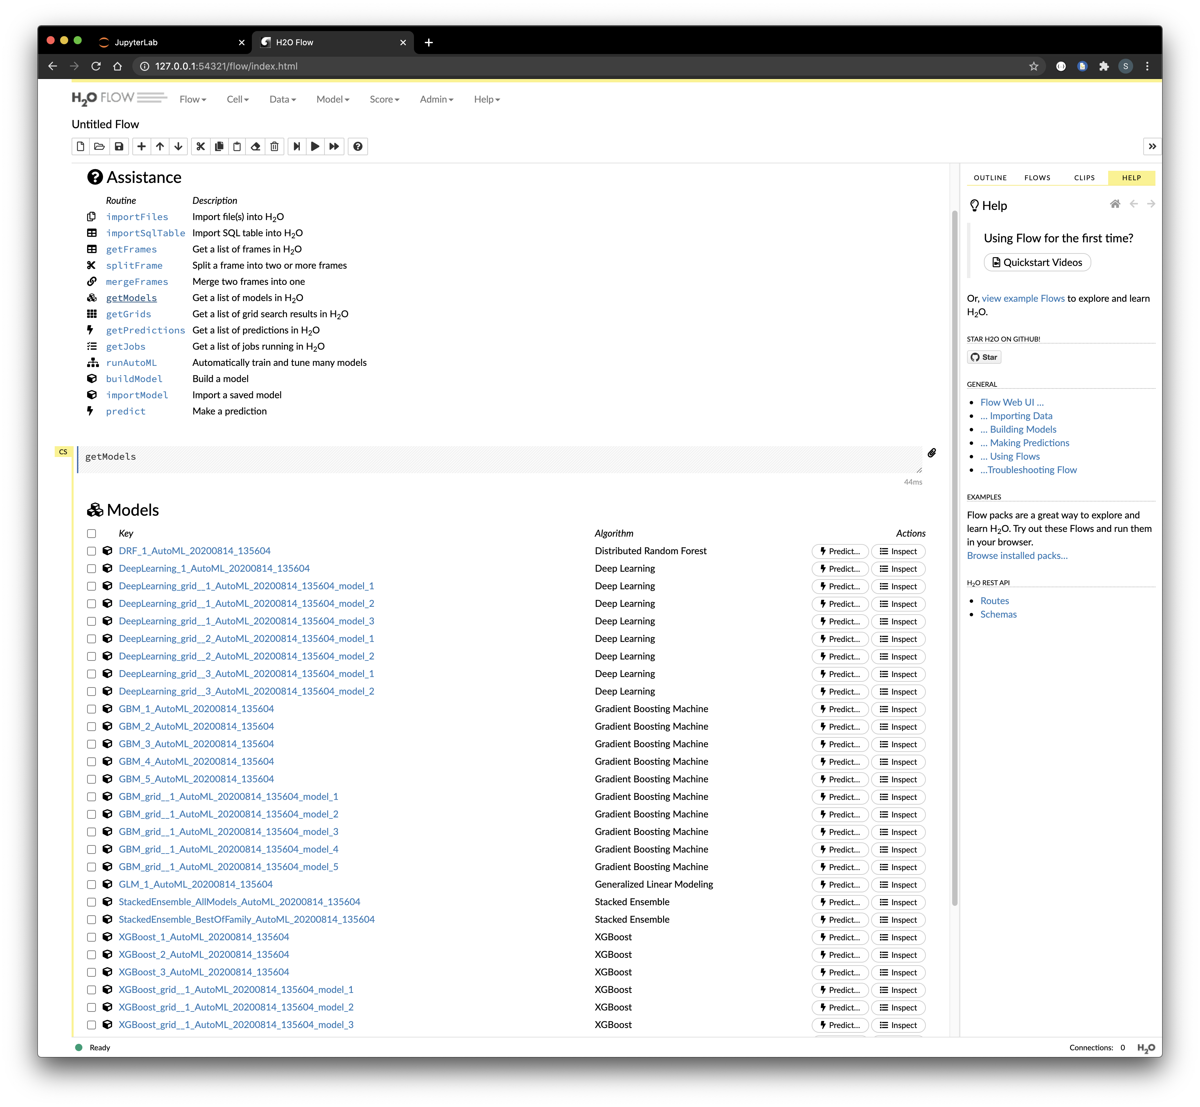
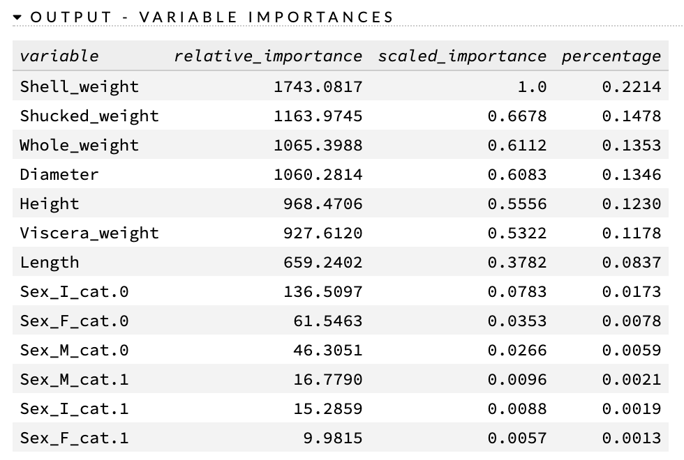
H2O AutoML: Web GUI
The web GUI can also provide detailed model info

Slide 21
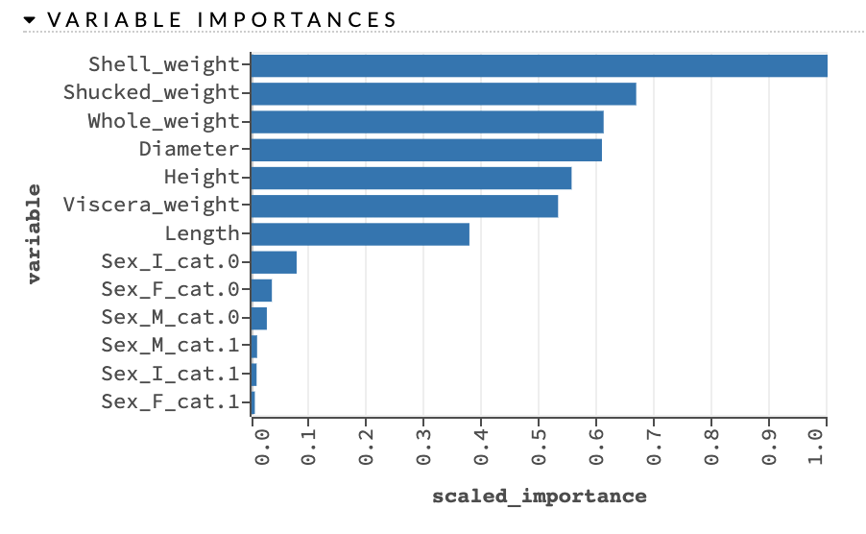
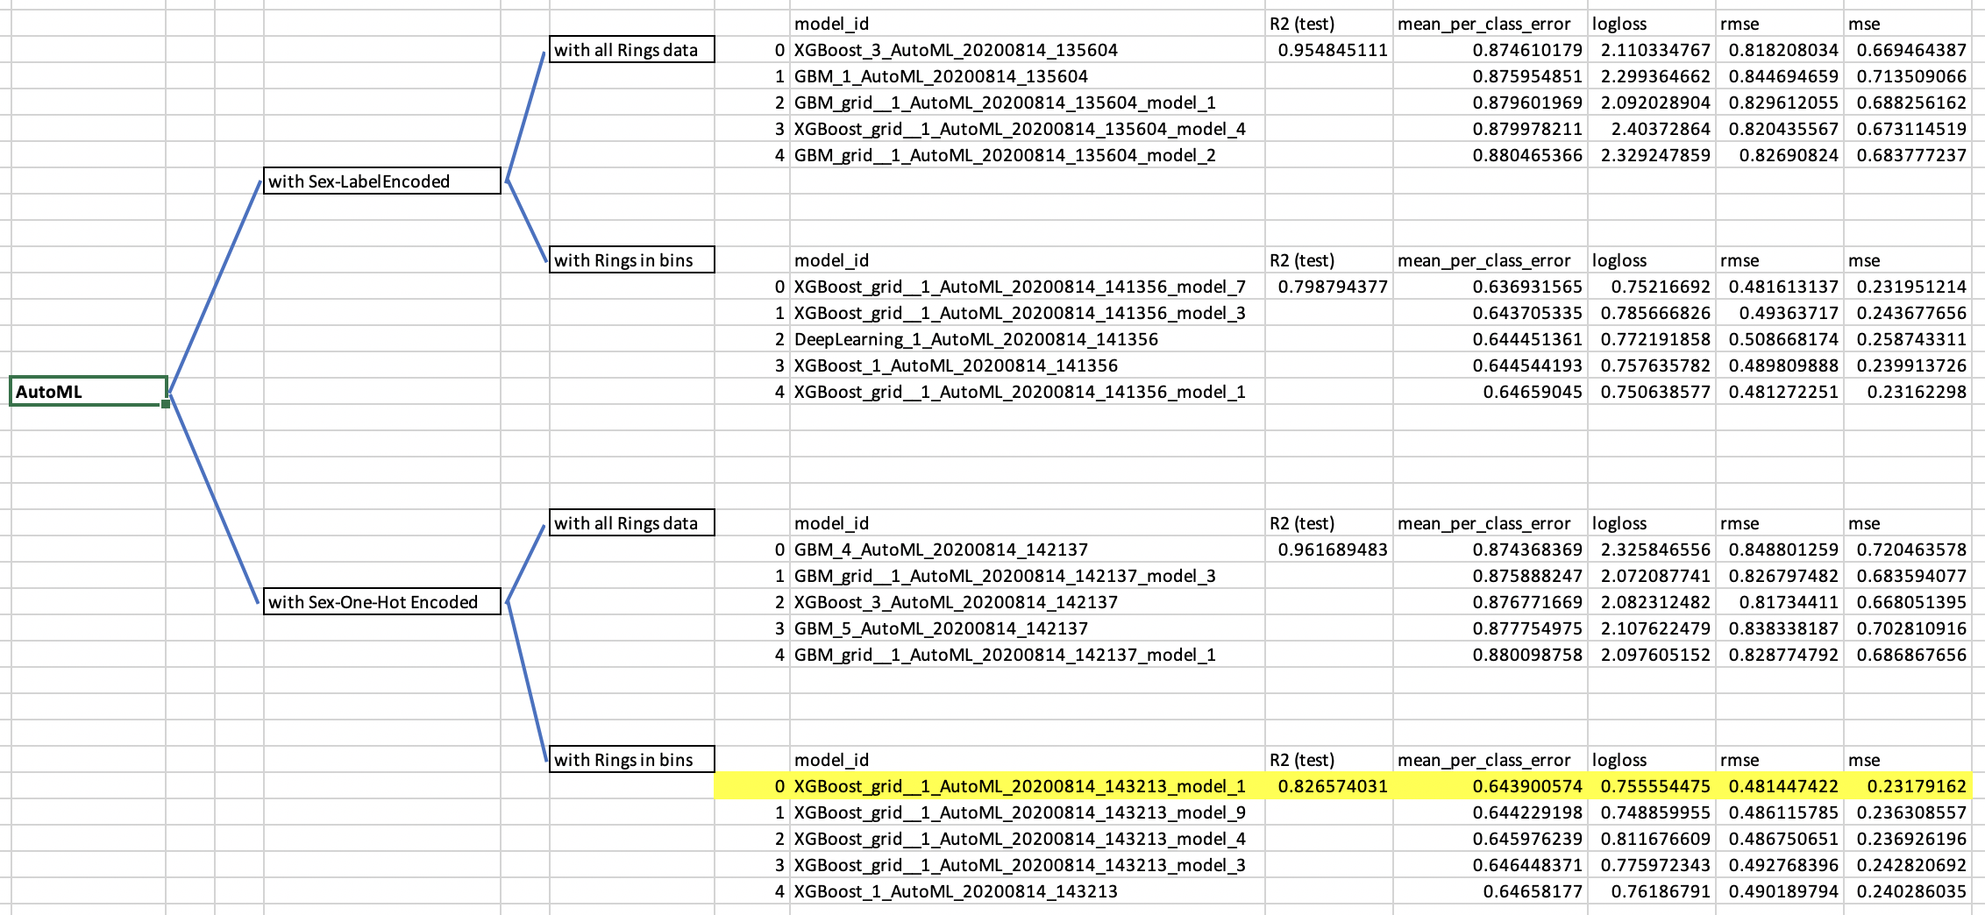
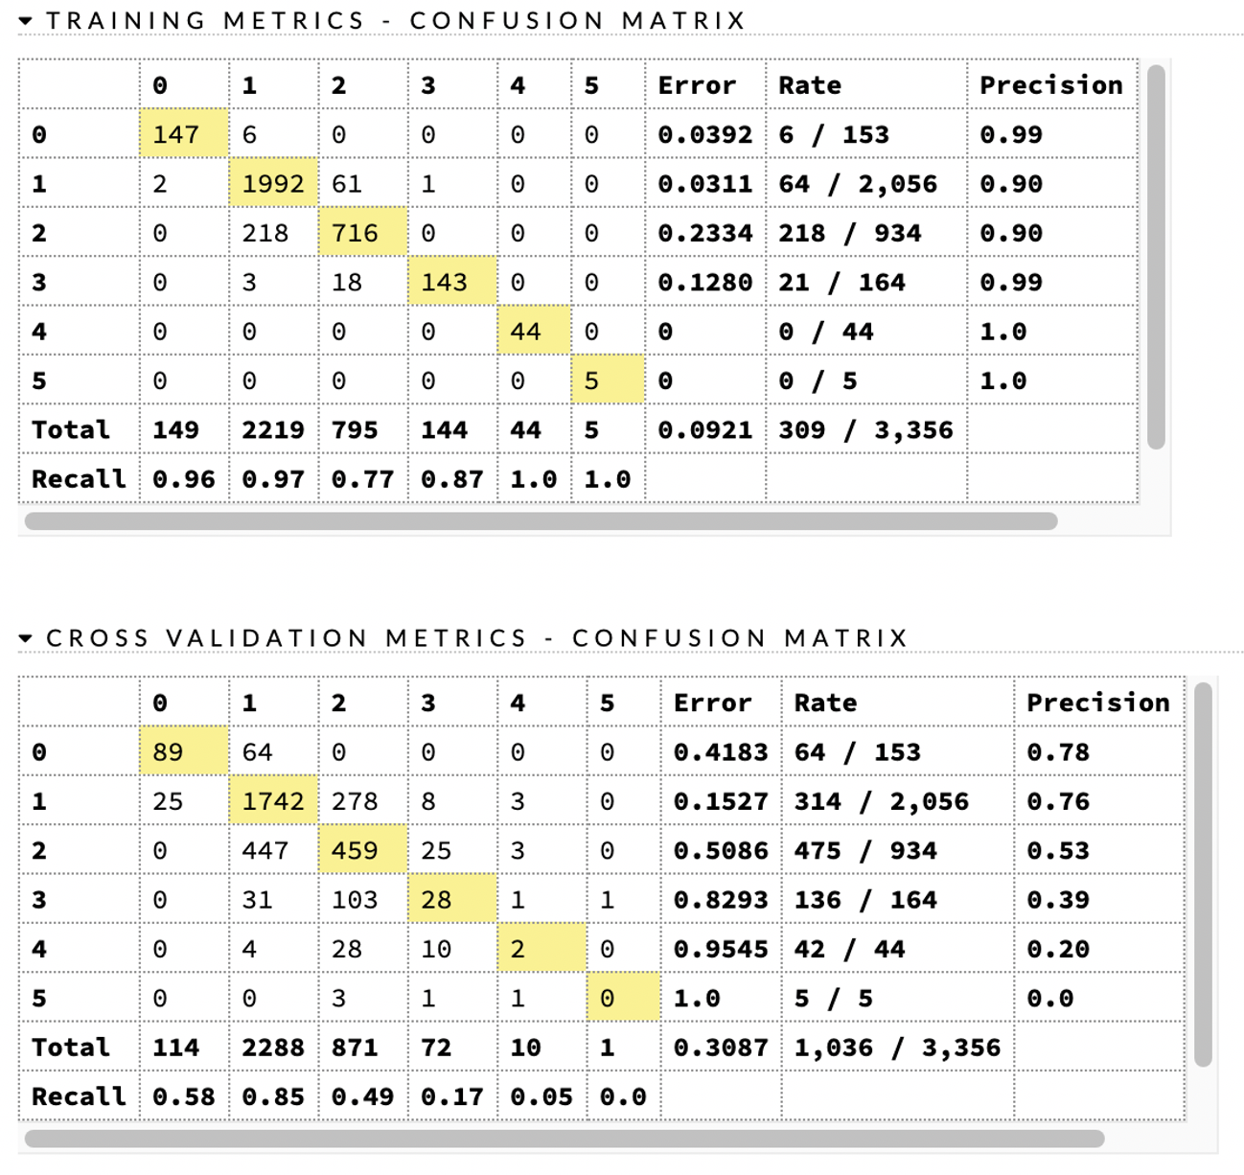
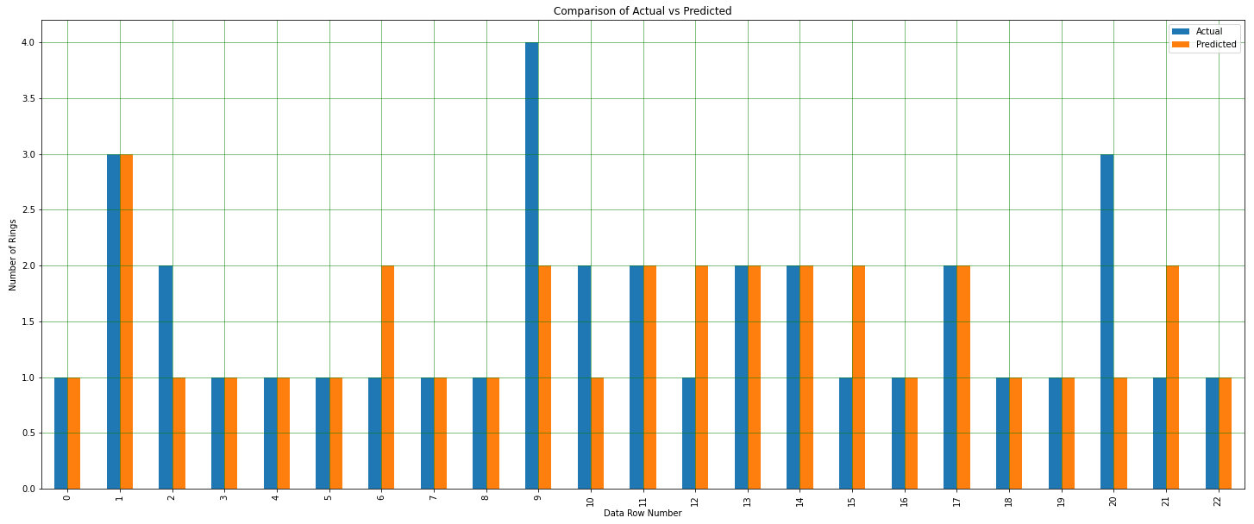
H2O AutoML: Modeling Plan and Results

Slide 22
Section break (Speaker change)

Slide 23
Neural Network Models
Slide text

Slide 24
Neural Network Models
Slide text

Slide 25
Section break (Speaker change)

Slide 26
Summary
Slide text

Slide 27
Summary
Slide text

Slide 28
Next Steps
Build a full-stack website to receive user-entered abalone characteristics and then predict the abalone age with different models

Slide 29
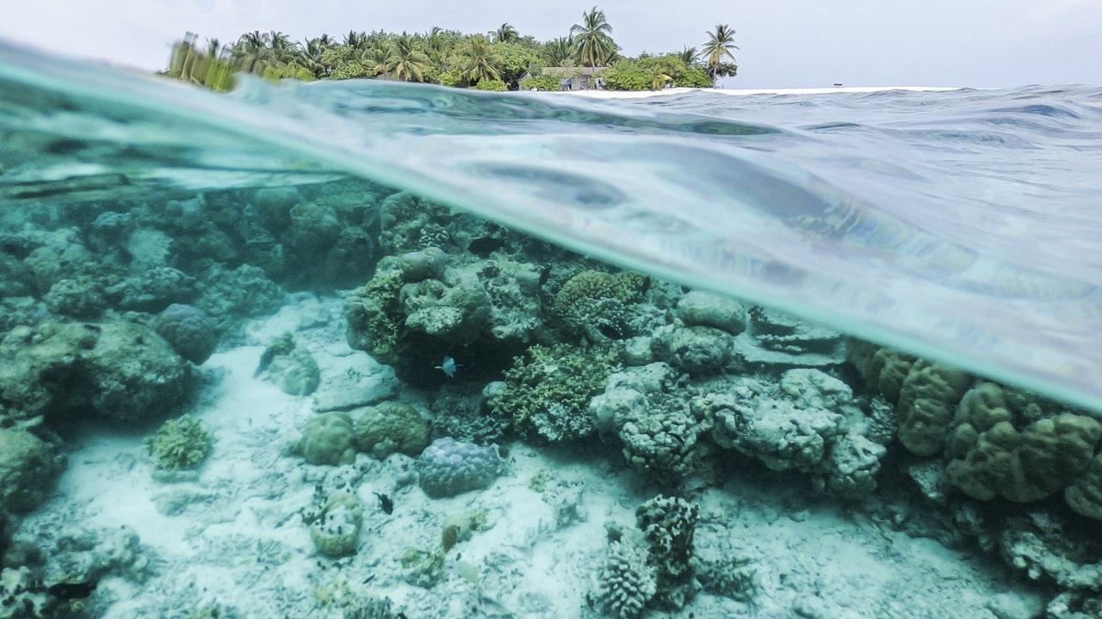
Any questions?

Slide 30
Extra blank slides below

Slide 31
Slide title
Slide text

Slide 32
Slide title
Slide text

Slide 33
Slide title
Slide text

